Slide 1
ECE20016-01/ITP20003 Java Programming Recursion
JC
Notes:
‹#›

Slide 2
Tentative Schedule
Weeks | Topics
1 | Introduction Java Runtime environments
2 | Object-orient concept Packages and objects
3 | Class and its members
4 | Language Basics, Branching and Loop
5 | String and Number classes
6 | Arrays, Recursion
7 | Inheritance, Polymorphism, and Interfaces Abstract data type and Interfaces
8 | Basic data structures ArrayList
9 | HashMap Midterm Exam
10 | Exception Handling, Streams and File I/O (1)
11 | Streams and File I/O (2), Java Programming practice (1)
12 | Java Programming practice (2), Dynamic Data structure and Generics (1)
13 | Dynamic Data structure and Generics (2) GUI and Event-driven Programming (1)
14 | GUI and Event-driven Programming (2), Concurrency (1)
15 | Concurrency (2) , Summary
16 | Final
* This schedule can be modified according to the students’ performance and other reasons.

Slide 3
Agenda
The Basics of Recursion

Slide 4
Basics of Recursion
A recursive algorithm will have one subtask that is a small version of the entire algorithm's task
A recursive algorithm contains an invocation of itself
Must be defined correctly otherwise algorithm could call itself forever or not at all

Slide 5
Basics of Recursion
Why and When is recursion useful???? Interesting discussions from real developers about recursion
https://stackoverflow.com/questions/3021/what-is-recursion-and-when-should-i-use-it

Slide 6
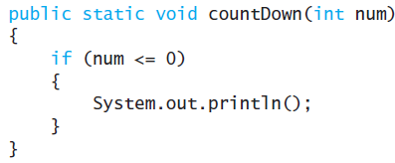
Simple Example - Countdown
Given an integer value num output all the numbers from num down to 1
First handle the simplest case; the base case or stopping condition
Ex)
Next handle larger cases (general case);
Phrase solution in terms of a smaller version of the same problem
Ex) countDown(3) is to output 3 then output the result of countDown(2)

Slide 7
Recursive Countdown
public class RecursiveCountdownDemonstrator
{
public static void main(String[] args)
{
countDown(3);
}
public statc void countDown(int num)
{
if (num <= 0) {
System.out.println();
} else {
System.out.print(num + " ");
countDown(num - 1);
}
}
}

Slide 8
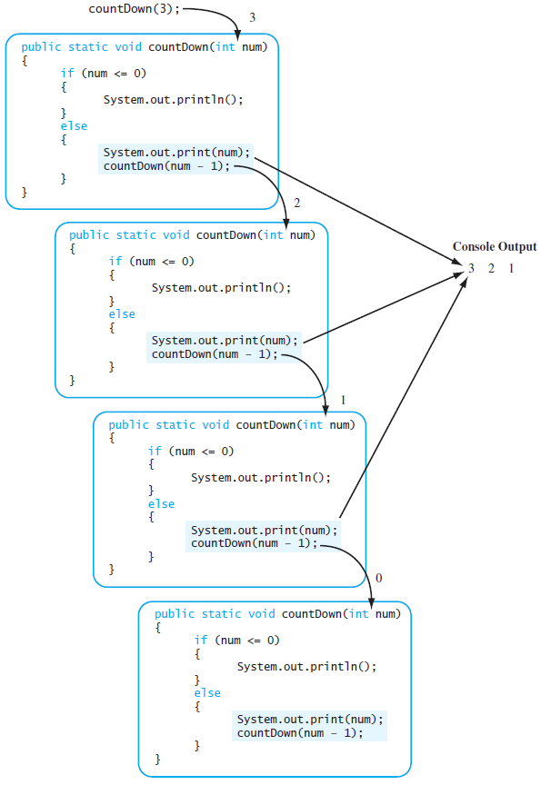
Sequence of Calls
Computing countDown(3)

Slide 9
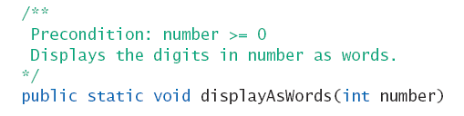

Case Study
Digits to Words
Receive an integer parameter
Then, print the digits of the number as words
Heading
Consider this useful private method

Slide 10
Case Study
[base case] If number has single digit, display it as a word
[general case] If number has multiple digits, decompose algorithm into two subtasks
Display all digits but the last as words
First subtask is smaller version of original problem
Same as original task, one less digit
Display last digit as a word

Slide 11
Case Study
public static void displayAsWords (int number)
{
if (number < 10)
System.out.print (getWordFromDigit (number) + " ");
else { //number has two or more digits
displayAsWords (number / 10);
System.out.print (getWordFromDigit (number % 10) + " ");
}
}

Slide 12
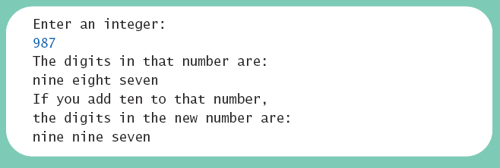
Case Study
class RecursionDemo
https://github.com/lifove/RecursionExample.git
https://github.com/lifove/RecursionExample/blob/master/src/main/java/edu/handong/csee/java/example/RecursionDemo.java
Result

Slide 13
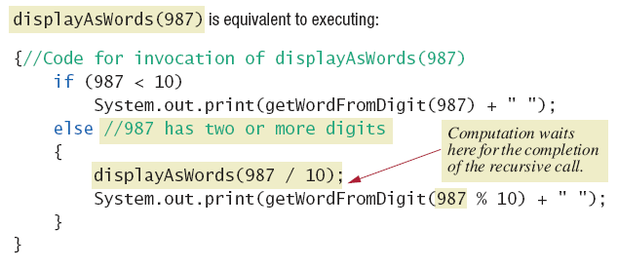
How Recursion Works
Executing recursive call

Slide 14
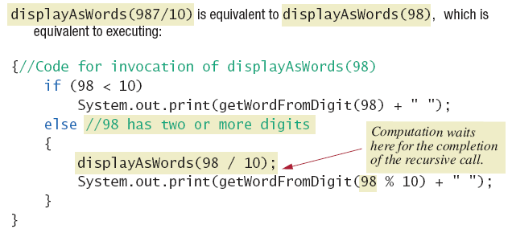
How Recursion Works
Executing recursive call

Slide 15
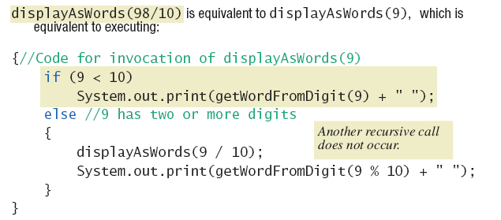
How Recursion Works
Executing recursive call

Slide 16
Keys to Successful Recursion
Must have a branching statement that leads to different cases
One or more of the branches should have a recursive call of the method
Recursive call must be a "smaller" version of the original argument.
One or more branches must include no recursive call
This is the base or stopping case

Slide 17
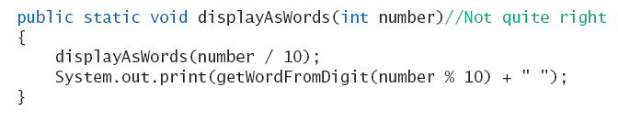
Infinite Recursion
Suppose we leave out the stopping case
Nothing stops the method from repeatedly invoking itself
Program will eventually crash when computer exhausts its resources (stack overflow)

Slide 18
Recursive vs. Iterative
Any method including a recursive call can be rewritten to do the same task without recursion
Non recursive algorithm uses iteration
Method which implements is iterative method
class IterativeDemo
https://github.com/lifove/RecursionExample/blob/master/src/main/java/edu/handong/csee/java/example/IterativeDemo.java

Slide 19
Recursive vs. Iterative
Recursive method
Uses more storage space than iterative version
Overhead during runtime
Also runs slower
However in some programming tasks, recursion is a better choice, a more elegant solution

Slide 20
Better Ways?
By using the String class

Slide 21
Tail recursion optimization
If we can write a recursive call that is not need necessarily to return, then a compiler can replace the current stack frame with new one. So we can avoid the stack overflow.
https://www.geeksforgeeks.org/why-is-tail-recursion-optimization-faster-than-normal-recursion/ "If the last action of a method is a call to another method, instead of creating a new stack frame for the context of the new method (arguments, local variables, etc.), we can replace the current one."
However, Java does not support the tail call optimization: https://stackoverflow.com/questions/53354898/tail-call-optimisation-in-java
Workaround: https://blog.knoldus.com/tail-recursion-in-java-8/ (You can't understand this now as you did not learn about lambda expression. If you like challenges, you can try ;))

Slide 22
Agenda
The Basics of Recursion
Programming with Recursion

Slide 23
Case Study
Binary Search
We design a recursive method to tell whether or not a given number is in an array
Algorithm assumes array is sorted.
First we look in the middle of the array
Then look in first half or last half, depending on value found in middle

Slide 24
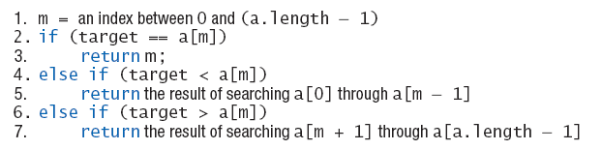
Binary Search
Draft 1 of algorithm
Algorithm requires additional parameters

Slide 25
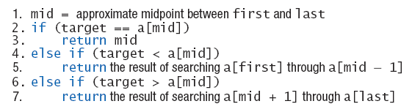
Binary Search
Draft 2 of algorithm to search a[first] through a[last]
What if target is not in the array?

Slide 26
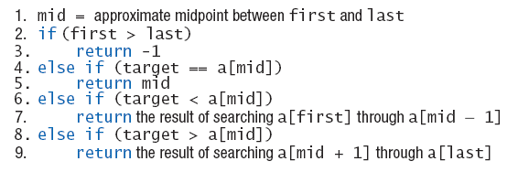
Binary Search
Final draft of algorithm to search a[first] through a[last] to find target

Slide 27
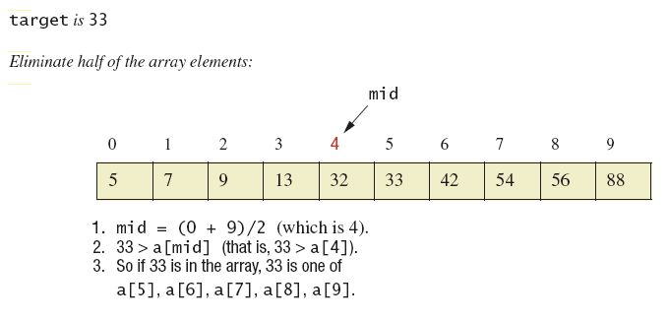
Binary Search
Binary search example

Slide 28
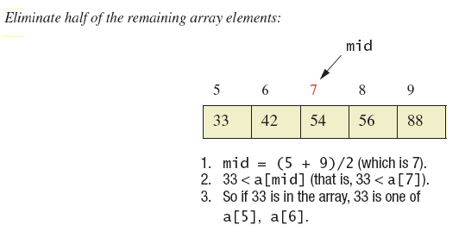
Binary Search
Binary search example

Slide 29
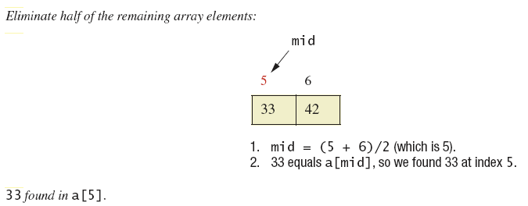
Binary Search
Binary search example

Slide 30
Binary Search
View final code, listing 11.6, class ArraySearcher
private int binarySearch (int target, int first, int last)
{
int result;
if (first > last)
result = -1;
else {
int mid = (first + last) / 2;
if (target == a [mid])
result = mid;
else if (target < a [mid])
result = binarySearch (target, first, mid - 1);
else //(target > a[mid])
result = binarySearch (target, mid + 1, last);
}
return result;
}
Note demo program, listing 11.7, class ArraySearcherDemo

Slide 31
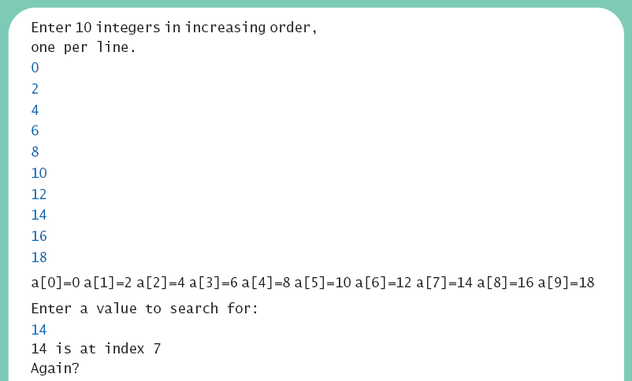
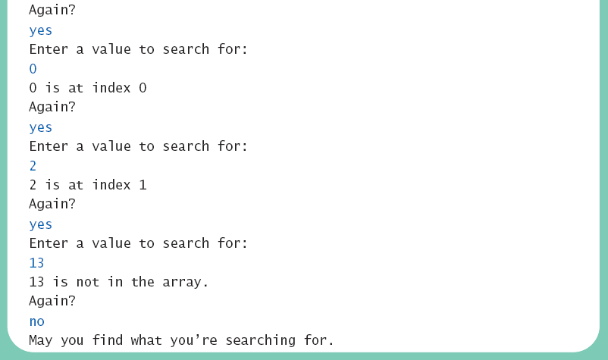
Binary Search

Slide 32
Programming Example
Merge sort – A recursive sorting method
A divide-and-conquer algorithm
Array to be sorted is divided in half
The two halves are sorted by recursive calls
This produces two smaller, sorted arrays which are merged to a single sorted array

Slide 33
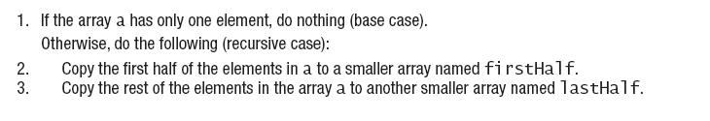

Merge Sort
Algorithm to sort array a

Slide 34
Merge Sort
View Java implementation, listing 11.8, class MergeSort
public static void sort (int [] a)
{
if (a.length >= 2) {
int halfLength = a.length / 2;
int [] firstHalf = new int [halfLength];
int [] lastHalf = new int [a.length - halfLength];
divide (a, firstHalf, lastHalf);
sort (firstHalf);
sort (lastHalf);
merge (a, firstHalf, lastHalf);
}
//else do nothing. a.length == 1, so a is sorted.
}

Slide 35
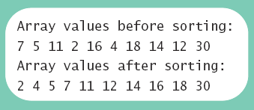
Merge Sort
View demo program, listing 11.9 class MergeSortDemo

Slide 36
Tentative Schedule
Weeks | Topics
1 | Introduction Java Runtime environments
2 | Object-orient concept Packages and objects
3 | Class and its members
4 | Language Basics, Branching and Loop
5 | String and Number classes
6 | Arrays, Recursion
7 | Inheritance, Polymorphism, and Interfaces Abstract data type and Interfaces
8 | Basic data structures ArrayList
9 | HashMap Midterm Exam
10 | Exception Handling, Streams and File I/O (1)
11 | Streams and File I/O (2), Java Programming practice (1)
12 | Java Programming practice (2), Dynamic Data structure and Generics (1)
13 | Dynamic Data structure and Generics (2) GUI and Event-driven Programming (1)
14 | GUI and Event-driven Programming (2), Concurrency (1)
15 | Concurrency (2) , Summary
16 | Final
* This schedule can be modified according to the students’ performance and other reasons.

Slide 37

JC Nam, jcnam@handong.edu, https://lifove.github.io

